Slide 1
Operations Management
William J. Stevenson
8th edition

Slide 2
CHAPTER
14
JIT and
Lean Operations
Operations Management, Eighth Edition, by William J. Stevenson
Copyright © 2005 by The McGraw-Hill Companies, Inc. All rights reserved.
McGraw-Hill/Irwin

Slide 3
JIT/Lean Production
Just-in-time (JIT): A highly coordinated processing system in which goods move through the system, and services are performed, just as they are needed,
JIT ⬅ ➔ lean production
JIT ➔ pull (demand) system
JIT operates with very little “fat”

Slide 4
Goal of JIT
The ultimate goal of JIT is a balanced system.
Achieves a smooth, rapid flow of materials through the system

Slide 5
Summary JIT Goals and Building Blocks
Figure 14.1
Ultimate
Goal
A
balanced
rapid flow
Supporting
Goals
Eliminate disruptions
Make the system flexible
Eliminate waste
Product
Design
Process
Design
Personnel
Elements
Manufactur-
ing Planning
Building
Blocks

Slide 6
Supporting Goals
Eliminate disruptions
Make system flexible
Eliminate waste, especially excess inventory

Slide 7
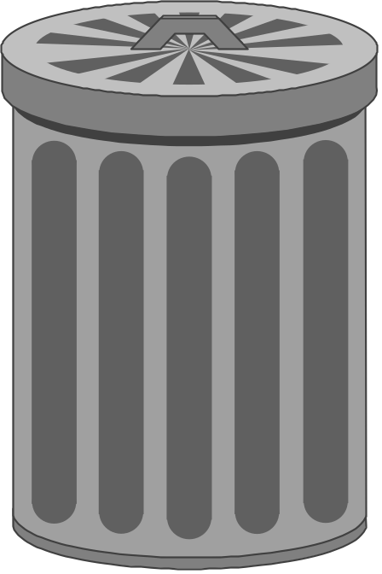
Sources of Waste
Overproduction
Waiting time
Unnecessary transportation
Processing waste
Inefficient work methods
Product defects

Slide 8
Big vs. Little JIT
Big JIT – broad focus
  Vendor relations
  Human relations
  Technology management
  Materials and inventory management
Little JIT – narrow focus
  Scheduling materials
  Scheduling services of production

Slide 9
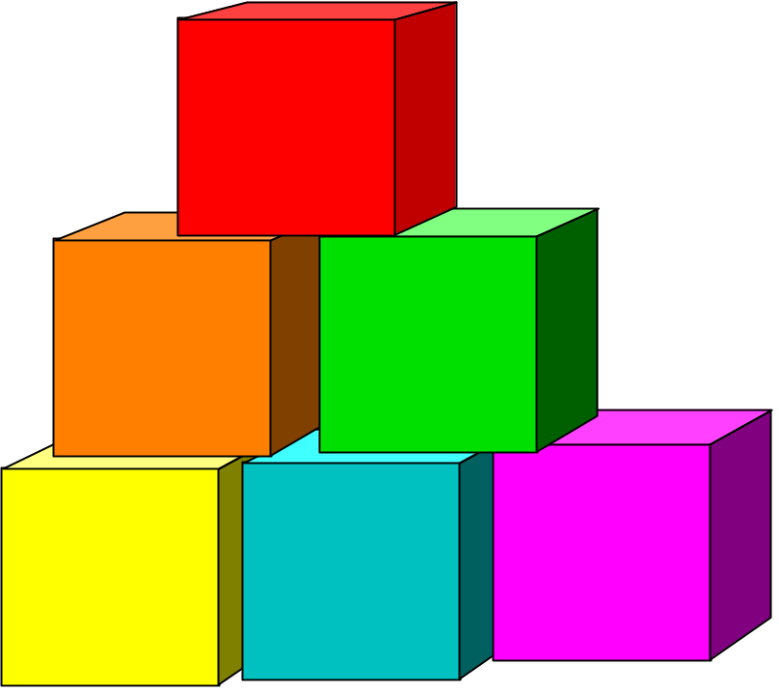
JIT Building Blocks
Product design
Process design
Personnel/organizational
elements
Manufacturing
planning and control

Slide 10
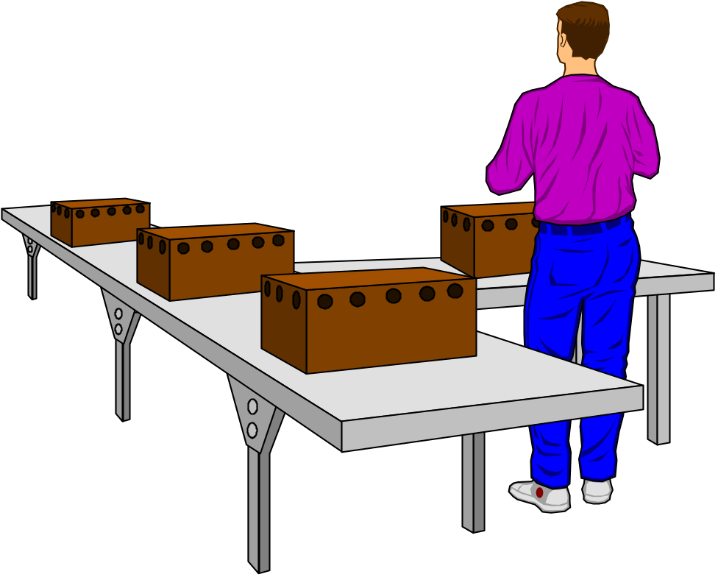
Product Design
Standard parts
Modular design
Highly capable production systems
Concurrent
engineering

Slide 11

Process Design
Small lot sizes
Setup time reduction
Manufacturing cells
Limited work in process
Quality improvement
Production flexibility
Little inventory storage

Slide 12


Benefits of Small Lot Sizes
Reduces inventory
Less rework
Less storage space
Problems are more apparent
Increases product flexibility
Easier to balance operations

Slide 13
Production Flexibility
Reduce downtime by reducing changeover time
Use preventive maintenance to reduce breakdowns
Cross-train workers to help clear bottlenecks

Slide 14
Production Flexibility (cont’d)
Use many small units of capacity
Use off-line buffers
Reserve capacity for important customers

Slide 15
Quality Improvement
Autonomation
  Automatic detection of defects during production
Jidoka
  Japanese term for autonomation

Slide 16

Personnel/Organizational Elements
Workers as assets
Cross-trained workers
Continuous improvement
Cost accounting
Leadership/project management

Slide 17
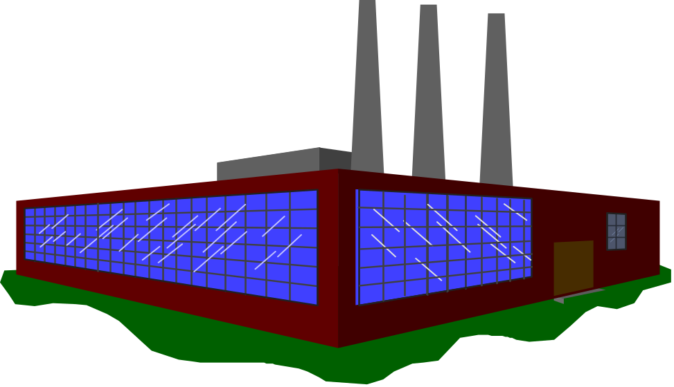
Manufacturing Planning and Control
Level loading
Pull systems
Visual systems
Close vendor relationships
Reduced transaction processing
Preventive maintenance

Slide 18
Pull/Push Systems
Pull system: System for moving work where a workstation pulls output from the preceding station as needed. (e.g. Kanban)
Push system: System for moving work where output is pushed to the next station as it is completed

Slide 19
Kanban Production Control System
Kanban: Card or other device that communicates demand for work or materials from the preceding station
Kanban is the Japanese word meaning “signal” or “visible record”
Paperless production control system
Authority to pull, or produce comes
from a downstream process.

Slide 20
Kanban Formula
DT(1+X)
N
=
C
N = Total number of containers
D = Planned usage rate of using work center
T = Average waiting time for replenishment of parts
plus average production time for a
container of parts
X = Policy variable set by management
- possible inefficiency in the system
C = Capacity of a standard container

Slide 21
Traditional Supplier Network
Figure 14.4a
Buyer
Supplier
Supplier
Supplier
Supplier
Supplier
Supplier
Supplier

Slide 22
Tiered Supplier Network
Figure 14.4b
Buyer
First Tier Supplier
Supplier
Second Tier Supplier
Supplier
Supplier
Third Tier Supplier
Supplier
Supplier
Supplier
Supplier

Slide 23
Comparison of JIT and Traditional
Table 14.3
Factor | Traditional | JIT
Inventory | Much to offset forecast errors, late deliveries | Minimal necessary to operate
Deliveries | Few, large | Many, small
Lot sizes | Large | Small
Setup; runs | Few, long runs | Many, short runs
Vendors | Long-term relationships are unusual | Partners
Workers | Necessary to do the work | Assets

Slide 24
Transitioning to a JIT System
Get top management commitment
Decide which parts need most effort
Obtain support of workers
Start by trying to reduce setup times
Gradually convert operations
Convert suppliers to JIT
Prepare for obstacles

Slide 25
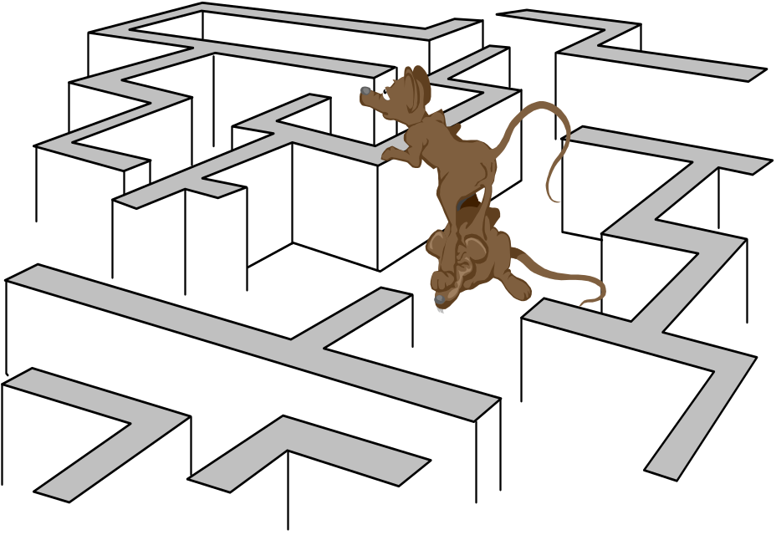
Obstacles to Conversion
Management may not be committed
Workers/management may not be cooperative
Suppliers may
resist
  Why?

Slide 26
JIT in Services
The basic goal of the demand flow technology in the service organization is to provide optimum response to the customer with the highest quality service and lowest possible cost.
  Eliminate disruptions
  Make system flexible
  Reduce setup and lead times
  Eliminate waste
  Minimize WIP
  Simplify the process

Slide 27
JIT II
JIT II: a supplier representative works right in the company’s plant, making sure there is an appropriate supply on hand.

Slide 28
Benefits of JIT Systems
Reduced inventory levels
High quality
Flexibility
Reduced lead times
Increased productivity

Slide 29
Benefits of JIT Systems (cont’d)
Increased equipment utilization
Reduced scrap and rework
Reduced space requirements
Pressure for good vendor relationships
Reduced need for indirect labor

Slide 30
Elements of JIT
Table 14.4
Smooth flow of work (the ultimate goal)
Elimination of waste
Continuous improvement
Eliminating anything that does not add value
Simple systems that are easy to manage
Use of product layouts to minimize moving materials and parts
Quality at the source

Slide 31
Elements of JIT (cont’d)
Table 14.4
Poka-yoke – fail safe tools and methods
Preventative maintenance
Good housekeeping
Set-up time reduction
Cross-trained employees
A pull system

